Slide 1
OPTIMIZING RESOURCE ALLOCATION FOR 5G NETWORKS USING ADVANCED MACHINE LEARNING TECHNIQUES
Team Members:
21i320 Karthik R
21i343 Prithiv Vijai U G
21i344 Pukalvanan L
21i366 Vinu V
Project Guide
Dr. Anitha Kumari K
Associate Professor
Department of Information Technology
PSG College of Technology
Coimbatore.

Slide 2
Agenda: -
Abstract
Literature Survey
Drawbacks of existing system
Proposed Methodology
Dataset
Block Diagram
Algorithm
Requirements
Timeline
References

Slide 3
Abstract: -
Optimizing resource allocation using advanced machine learning techniques to analyze key patterns and correlations in a comprehensive dataset, including fields like latency, allocated bandwidth, required bandwidth, signal strength, and resource allocation efficiency.
The project aims to predict and enhance system efficiency and responsiveness by dynamically allocating bandwidth and processing power, minimizing latency, and maximizing overall network performance, thereby improving user experience and service delivery.
The resource allocation efficiency is predicted using advanced machine leaning models which enable better understanding of network fields and their correlation contributing to better and optimized efficiency.

Slide 4
Literature Survey: -
S.No | Title and Authors of the paper | Publication Year and Conference | Inferences | Drawbacks
1. | 5G Traffic Prediction Based on Deep Learning. Zihang Gao. | Computational and Intelligence Neuroscience. (2022) | This paper introduces an SLSTM model for predicting 5G network traffic, which adapts its complexity and stabilizes output sequences, showing significant improvements over traditional methods. | The proposed SLSTM model could benefit from incorporating a broader spectrum of factors influencing 5G traffic to further enhance its predictive accuracy and applicability in real-world settings.
2. | Deep Learning Models Applied to Prediction of 5G Technology Adoption. Ikhlas Fuad Zamzami | Applied Sciences. (2023) | This paper employs DR, LSTM, and CNN deep learning models to predict 5G adoption factors using channel metrics, context metrics, cell metrics, and throughput data. It underscores the effectiveness of the proposed DR and CNN models, despite issues with LSTM's data quality. | ,The paper acknowledges limitations in dataset representation and the proposed deep learning algorithm's contextual understanding, suggesting potential for improvement in future research.

Slide 5
Cont’d: -
3. | Research on throughput prediction of 5G network based on LSTM. L. Li and T. Ye | Intelligent and Converged Networks. June 2022 | This paper proposes an LSTM-based wireless network traffic prediction model, showing promising prediction accuracy and training speed through simulations with different 5G service scheduling algorithms. | Further optimizations are needed for parameter settings and operational efficiency to enhance future performance and algorithm design.
4. | 5G Multi-Access Edge Computing: A Survey on Security, Dependability, and Performance. G. Nencioni, R. G. Garroppo and R. F. Olimid | IEEE Access. (2023) | This paper surveys security, dependability, and performance aspects of 5G Multi-access Edge Computing (MEC), providing insights into challenges and advancements through taxonomy and state-of-the-art findings. | The proposed joint addressing of security, dependability, and performance in 5G MEC requires further research to enhance robustness for evolving network demands.

Slide 6
Cont’d: -
5. | Edge Computing Resource Allocation Method for Mining 5G Communication System. L. Zhang, W. Yang, B. Hao, Z. Yang and Q. Zhao | IEEE Access. (2023) | This paper proposes an edge computing-based solution using 5G wireless base stations to enhance underground 5G communication in coal mines, significantly reducing task execution delay and improving transmission rates. | Further validation in diverse operational environments and scalability testing are needed to ensure robustness and effectiveness in real-world mining scenarios.
6. | Implementation and Evaluation of 5G MEC-Enabled Smart Factory. Rekoputra, N. M, Tseng, C.-W,Wang, J.-T, Liang, S.-H, Cheng, R.-G, Li, Y.-F, Yang, W.-H. | Electronics 12. (2023) | This paper demonstrates that integrating MEC with 5G networks enhances performance metrics significantly compared to non-MEC setups, WiFi 6, and Ethernet, crucial for Industry 4.0 applications. | The proposed MEC implementation requires authentication from MNOs for industrial networks, potentially restricting accessibility and deployment flexibility.

Slide 7
Cont’d: -
7. | Integrating Multi-Access Edge Computing (MEC) into Open 5G Core Xavier, Ruben, Rogério S. Silva, Maria Ribeiro, Waldir Moreira, Leandro Freitas, and Antonio Oliveira- | Telecom 5 (2024) | This paper proposes a new MTS API extension to integrate MEC with the 5G core, validating its feasibility in high-density scenarios like e-Health and Smart Farms, meeting 5G MEC applications. | The implementation and validation are performed in a virtualized environment, which may not fully replicate real-world conditions.
8. | Research on the 5G MEC Co-construction and Sharing | 2024 4th International Conference on Neural Networks, Information and Communication Engineering (NNICE), Guangzhou, China, (2024) | This paper explores 5G operator collaboration through co-construction and sharing to enhance network efficiency and reduce costs, focusing on NSA to SA network evolution and addressing security and performance challenges. | This paper doesn't provide real-world data on cost savings

Slide 8
Drawbacks of existing system: -
Increased Latency: Traditional methods cause higher latency.
Reduced Throughput: Lower data rates during peak times.
Scalability Issues: Difficult to scale resources effectively.
Inefficient Management: Poor resource allocation leads to spectral inefficiencies in 5G networks.
QoS Concerns: Maintaining consistent service quality is challenging.

Slide 9
Proposed Methodology: -
Multi-Edge Computing
Proximity:
MEC places computational resources and data storage facilities closer to end-users, typically at the network edge.
Situating these resources near the users reduces the distance data must travel for processing or retrieval, resulting in faster response times and reduced latency.
Decentralization and Local Processing:
Unlike traditional centralized data centers, MEC distributes computing and storage across multiple local edge nodes.
This setup allows for data to be processed locally, within or near the same geographic area as the user, improving efficiency and reducing the load on the core network.

Slide 10
Benefits
Reduced Latency:
Processes data closer to the client.
Minimizes the time for data to travel back and forth.
Increased Bandwidth:
Localized processing reduces data transmission over the core network.
Frees up bandwidth for other uses.
Improved Reliability:
Localized edge nodes can operate independently of the central data center.
Enhances overall system reliability.

Slide 11
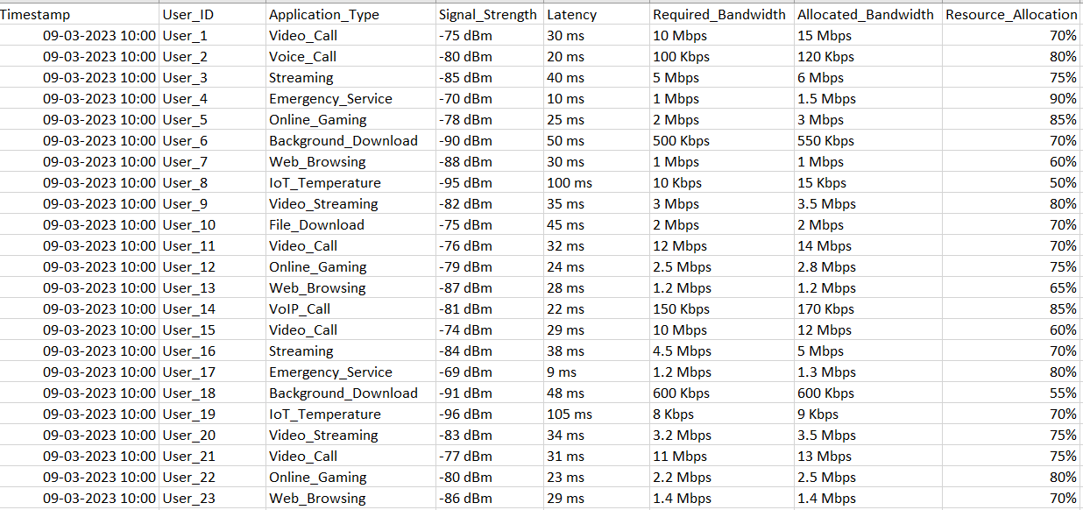
Dataset:
FEATURES :
Signal strength: -90 dBm (weak) to -30 dBm (strong)
Application Type: The type of application.
Latency: 0 ms (ideal) to 100 ms (realtime: 20 ms to 30 ms)
Req bw: varies by application (eg: 5-10 Mbps - HD video streaming, 3-6 Mbps - Online Gaming)
Allocated bw: exact or slightly exceed bw allocation, not lesser or over-provisioning.
Resource Allocation: Efficiency of allocated resource.

Slide 12
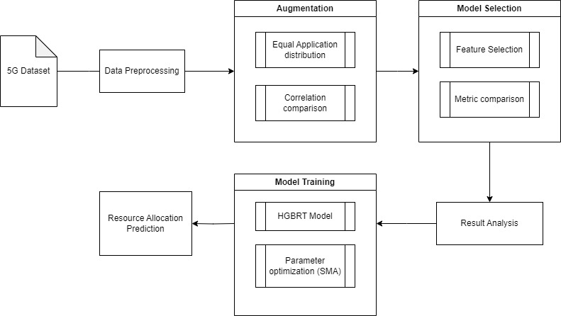
Block Diagram:

Slide 13
Algorithm: -
HISTOGRAM-BASED GRADIENT BOOSTING REGRESSION TREE (H-GBRT)
Purpose: Predict Resource allocation efficinecy.
Function: Forecast future resource requirements (CPU, memory, bandwidth) for applications and services on edge nodes.
Optimization: Parameters optimized using the Slime Mould Algorithm (SMA) to enhance prediction accuracy, enabling pre-emptive resource allocation and handling varying workloads without compromising performance.
PROXIMAL POLICY OPTIMIZATION (PPO)
Purpose: Dynamic resource allocation in MEC based on predicted resource demands.
Function: PPO is a reinforcement learning algorithm that learns to allocate resources dynamically by interacting with the MEC environment. It makes real-time decisions to optimize the allocation of resources like CPU, memory, and bandwidth to different applications.

Slide 14
Environment Setup: -
Install Python and Required Libraries: Ensure Python and necessary libraries are installed.
Set Up Environment: Use Jupyter Notebook or Google Colab for code implementation.
Data Collection and Model Training: Collect data, train H-GBRT, and optimize with SMA.
Run the Hybrid Model: Implement and execute the central server, edge nodes, and client nodes using python for concurrency.

Slide 15
Requirements
Hardware Requirements:
Processor: Intel i5 series
RAM: 8 GB
GPU: 4 GB
Software Requirements:
Operating System: Windows 10, MacOS
Coding Language: Python
Packages: Keras, Torch, Matplotlib, Tensorflow, Random, Pandas, Scikit-learn, NumPy ,Plotly , Dash
IDE: Google Colaboratory, Visual Studio Code

Slide 16
Implementation
Data Preprocessing
Data Augmentation
Model Training
Result analysis

Slide 17
Preprocessing
Original Dataset
Timestamp attribute removed.
Numeric encoding for application_type.
Converted Required_bandwidth , Allocated_bandwidth to same units.
Removed ‘%’ , ‘dBm’ , ‘ms’ from respective attributes.
User_Id to contain only the ID.
Timestamp | User_ID | Application_Type | Signal_Strength | Latency | Required_Bandwidth | Allocated_Bandwidth | Resource_Allocation
09-03-2023 10:00 | User_1 | Video_Call | -75 dBm | 30 ms | 10 Mbps | 15 Mbps | 70%
09-03-2023 10:00 | User_2 | Voice_Call | -80 dBm | 20 ms | 100 Kbps | 120 Kbps | 80%
09-03-2023 10:00 | User_3 | Streaming | -85 dBm | 40 ms | 5 Mbps | 6 Mbps | 75%
09-03-2023 10:00 | User_4 | Emergency_Service | -70 dBm | 10 ms | 1 Mbps | 1.5 Mbps | 90%
09-03-2023 10:00 | User_5 | Online_Gaming | -78 dBm | 25 ms | 2 Mbps | 3 Mbps | 85%
09-03-2023 10:00 | User_6 | Background_Download | -90 dBm | 50 ms | 500 Kbps | 550 Kbps | 70%
09-03-2023 10:00 | User_7 | Web_Browsing | -88 dBm | 30 ms | 1 Mbps | 1 Mbps | 60%
09-03-2023 10:00 | User_8 | IoT_Temperature | -95 dBm | 100 ms | 10 Kbps | 15 Kbps | 50%
09-03-2023 10:00 | User_9 | Video_Streaming | -82 dBm | 35 ms | 3 Mbps | 3.5 Mbps | 80%
Preprocessed Dataset
User_ID | Application_Type | Signal_Strength | Latency | Required_Bandwidth | Allocated_Bandwidth | Resource_Allocation
1 | 6 | -75 | 30 | 10000 | 15000 | 70
2 | 9 | -80 | 20 | 100 | 120 | 80
3 | 5 | -85 | 40 | 5000 | 6000 | 75
4 | 1 | -70 | 10 | 1000 | 1500 | 90
5 | 4 | -78 | 25 | 2000 | 3000 | 85
6 | 0 | -90 | 50 | 500 | 550 | 70
7 | 10 | -88 | 30 | 1000 | 1000 | 60
8 | 3 | -95 | 100 | 10 | 15 | 50
9 | 7 | -82 | 35 | 3000 | 3500 | 80

Slide 18
Data Augmentaion
Augmented 400 records to 16000 records
Ensured equal distribution of data across each application_type.
Compared the correlation difference for Gaussian_noise augmentation and GAN augmentation.
Made sure the average values for each feature remained the same.
Similar correlation was produced.

Slide 19
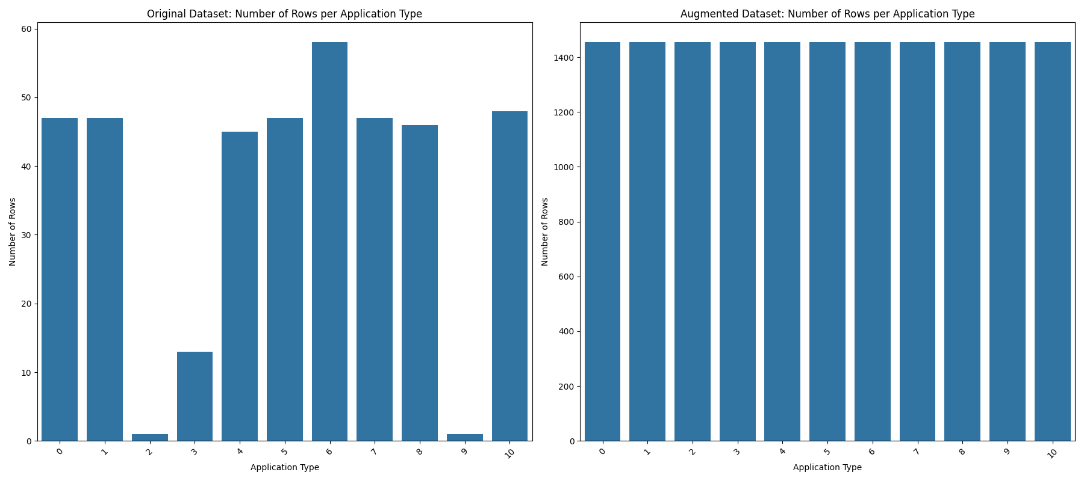
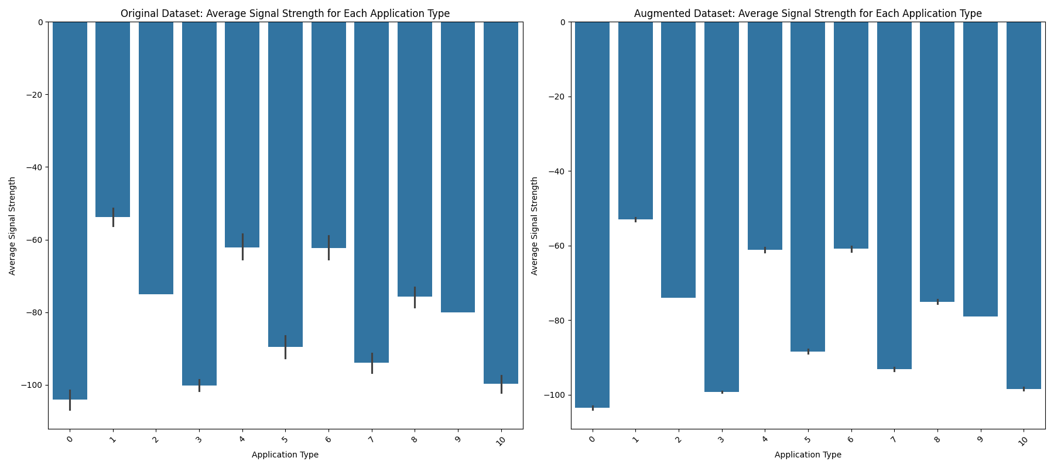
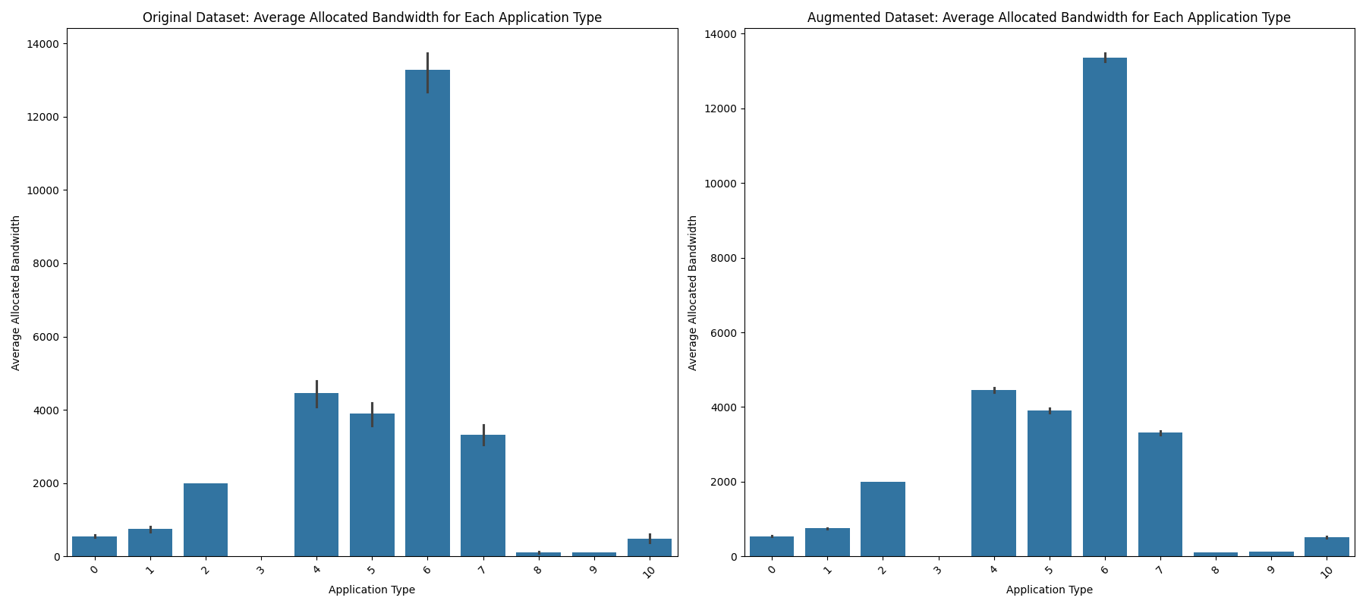
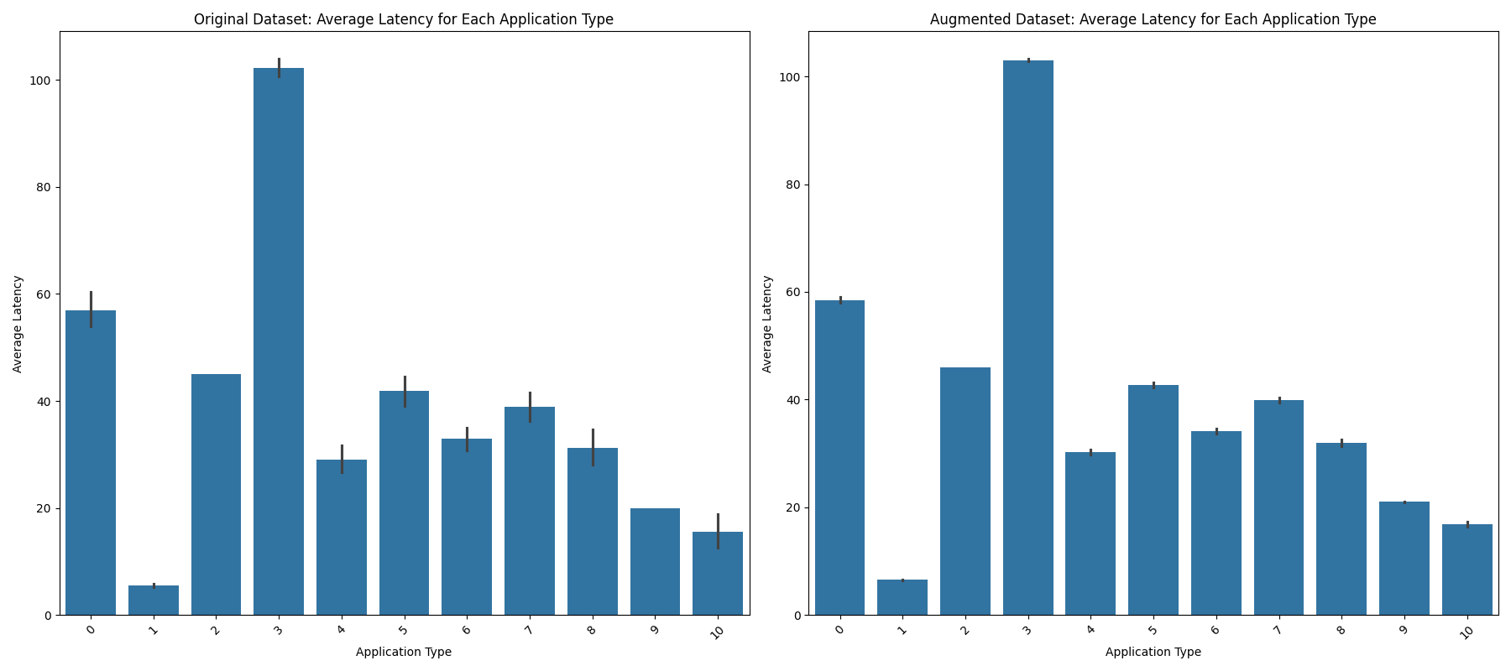
Data Augmentaion – Comparitive Analysis

Slide 20
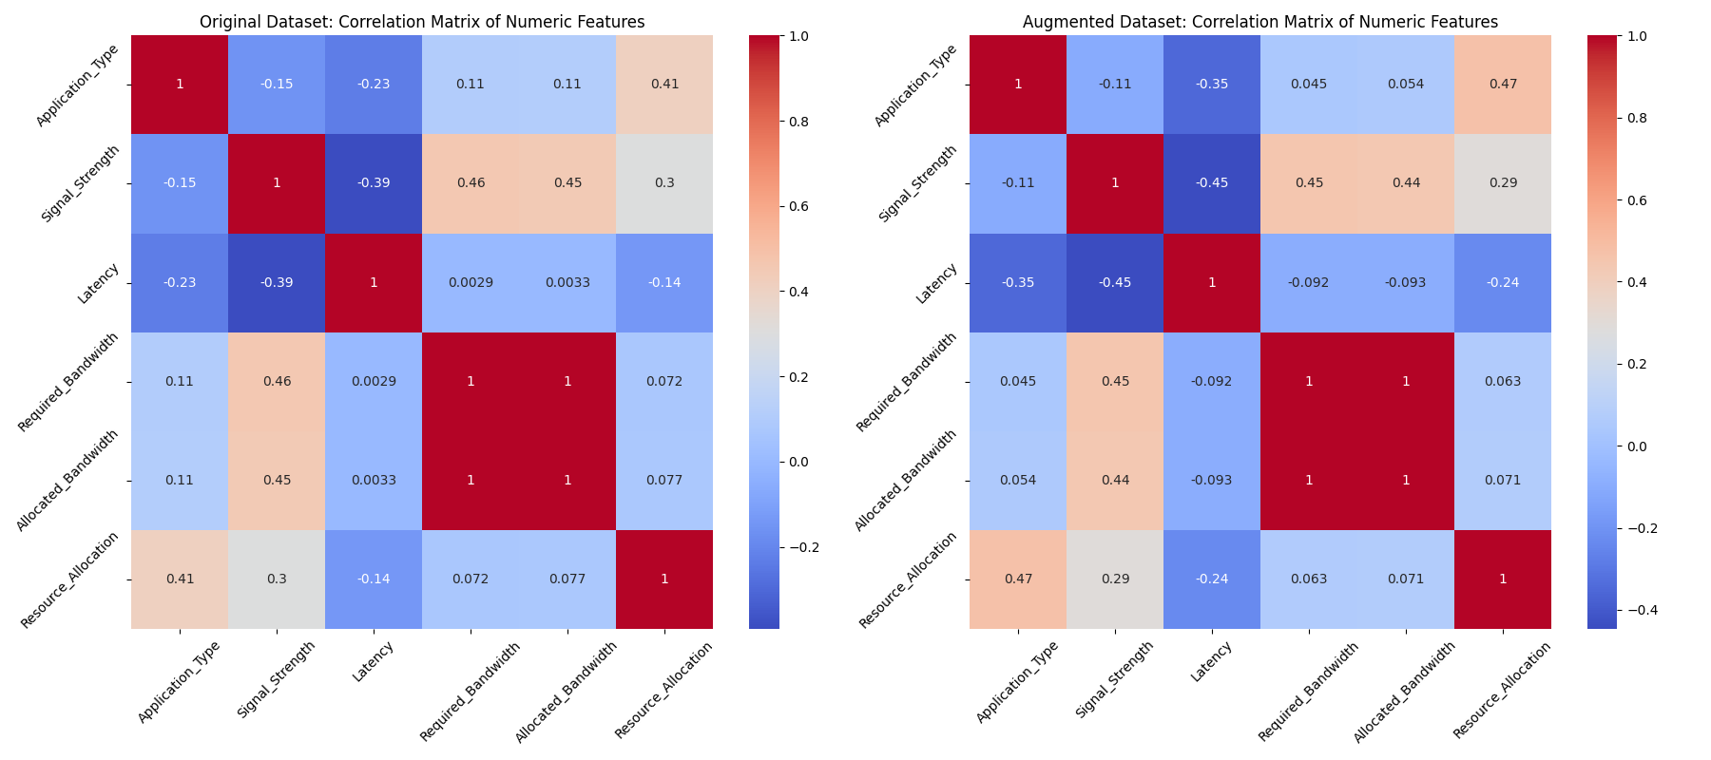
Data Augmentation – Correlation Comparison

Slide 21
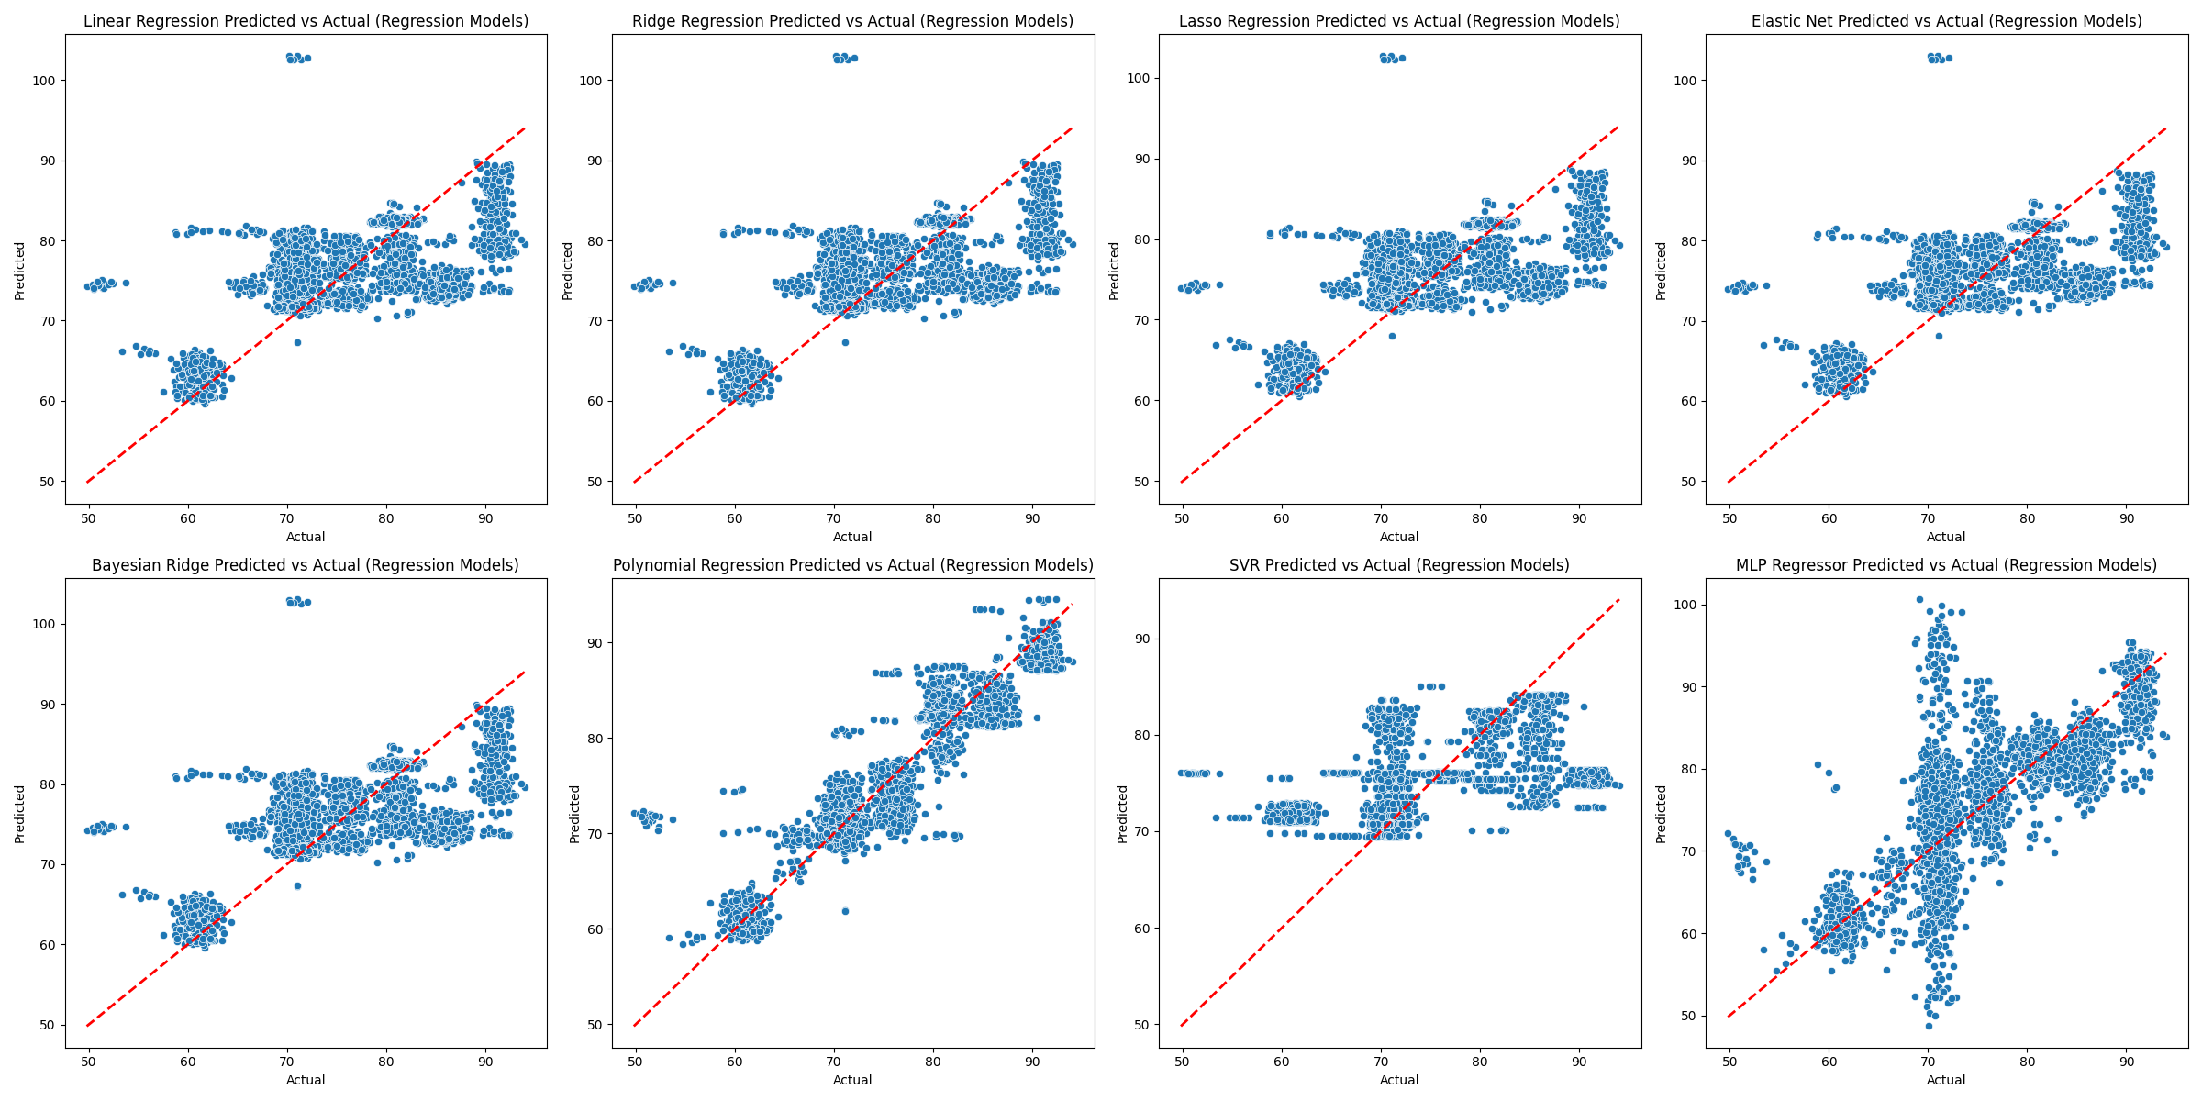
Regression models - Actual vs Predicted

Slide 22
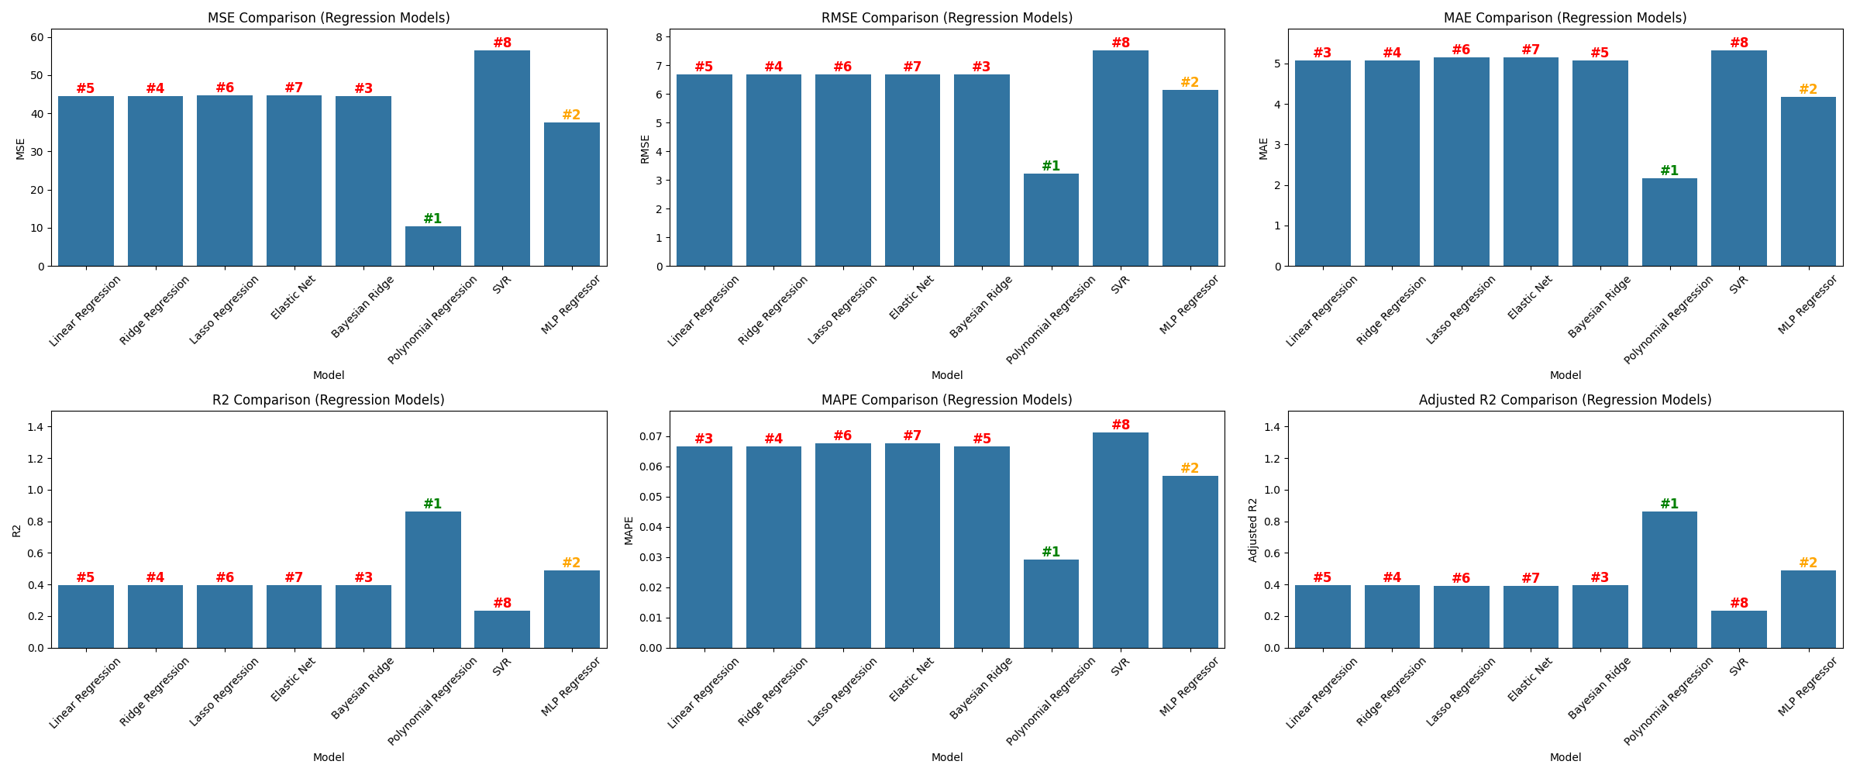
Regression models – Metric comparison

Slide 23
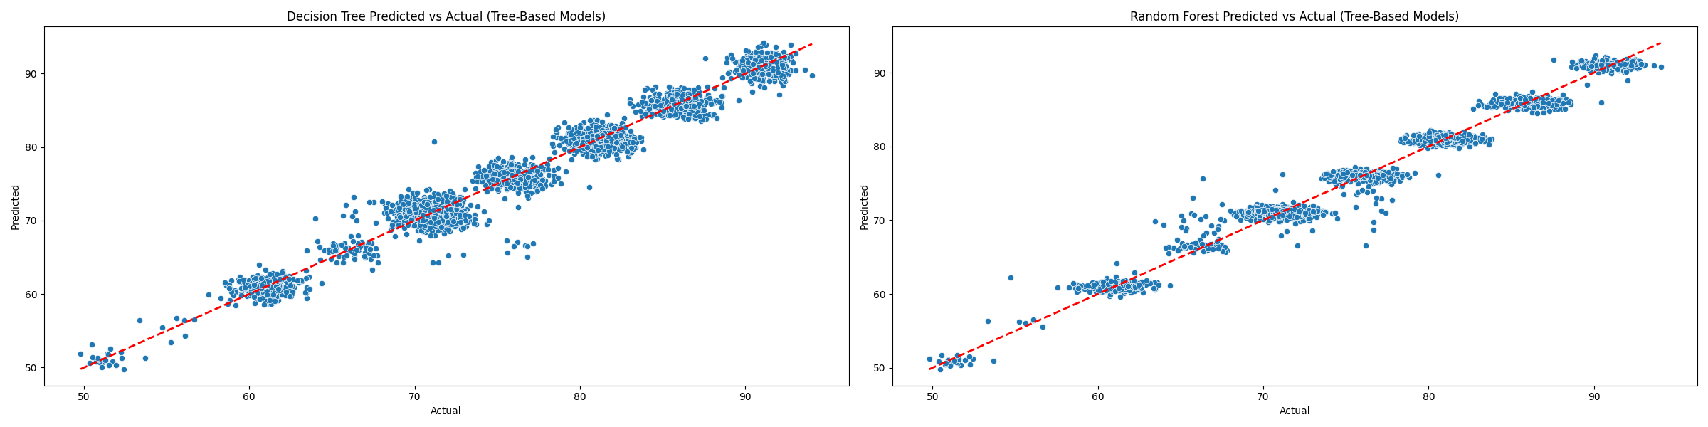
Tree based models– Actual vs Predicted

Slide 24
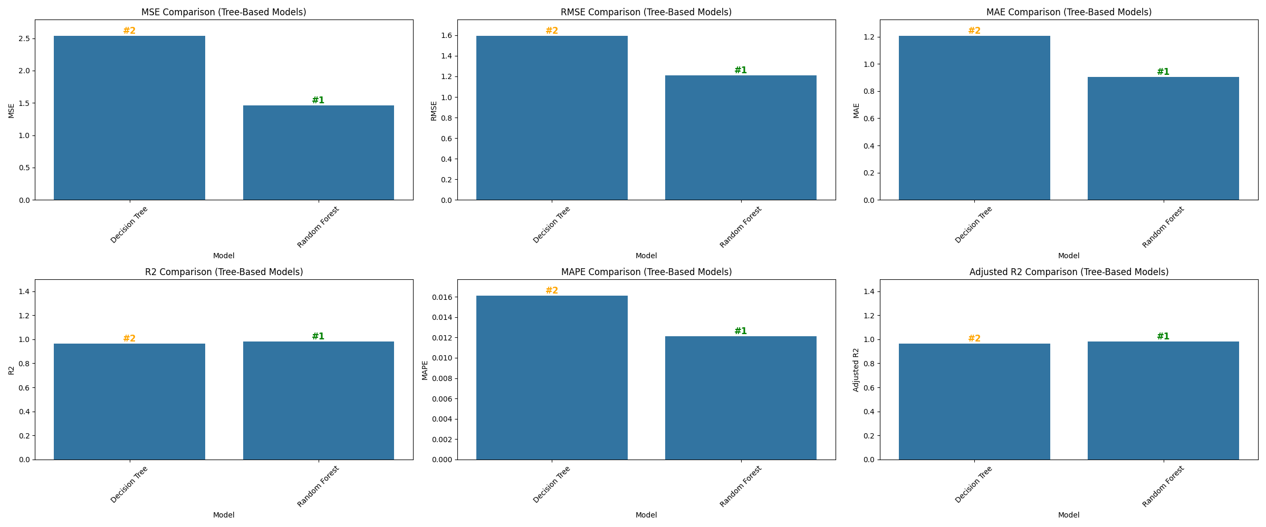
Tree based models – Metrics Comparison

Slide 25
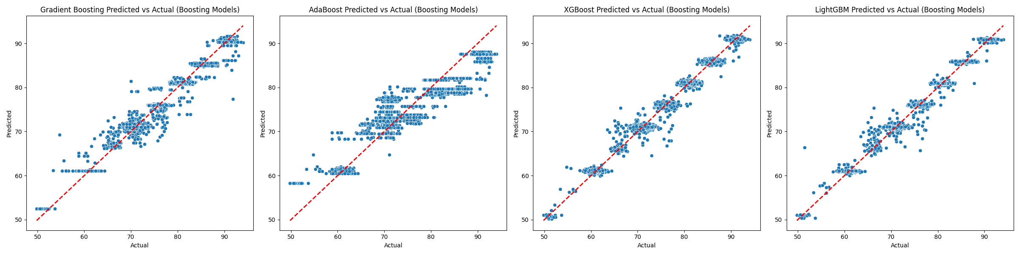
Boosting models– Actual vs Predicted

Slide 26
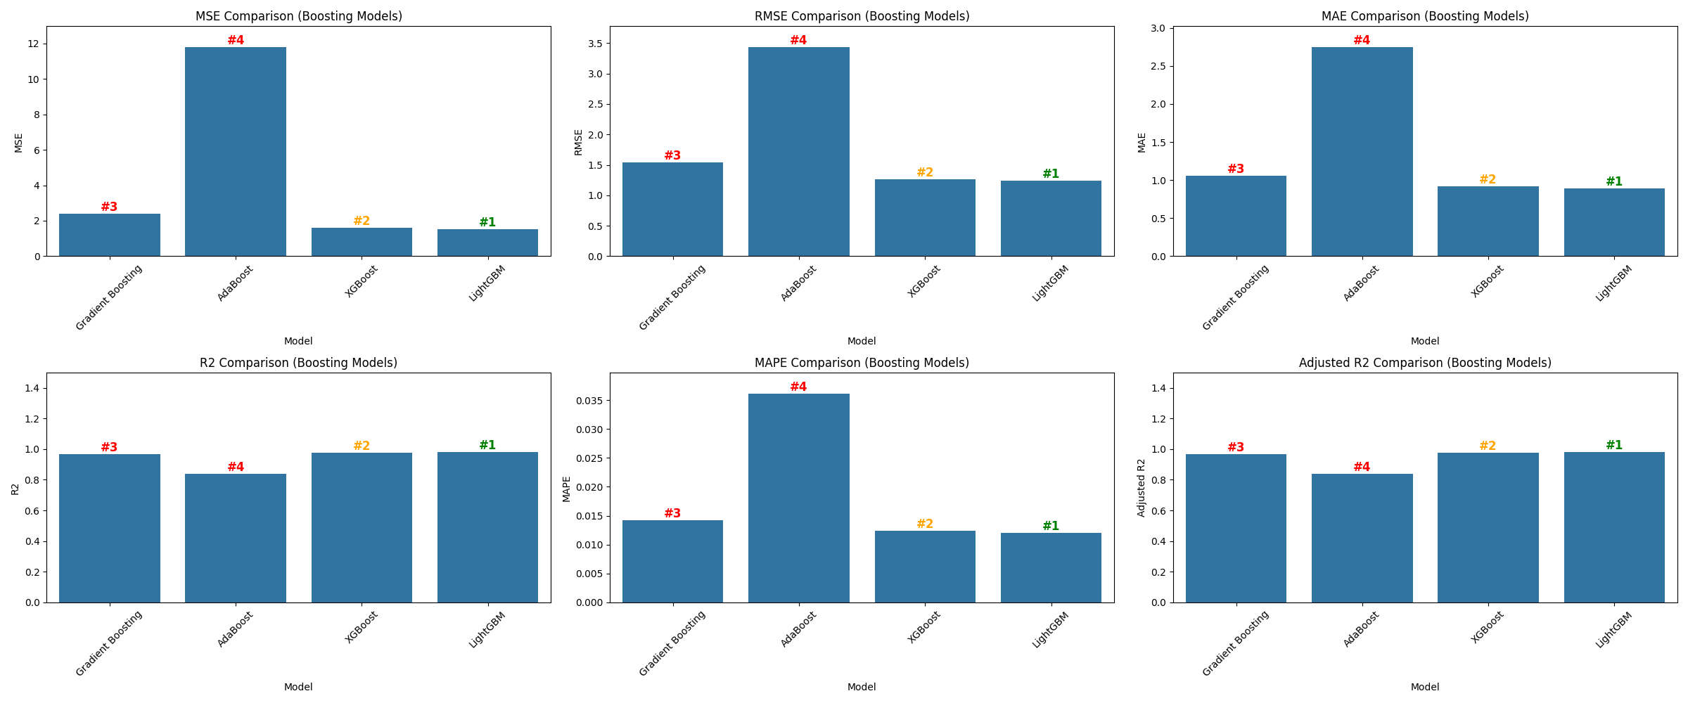
Boosting models – Metrics Comparison

Slide 27
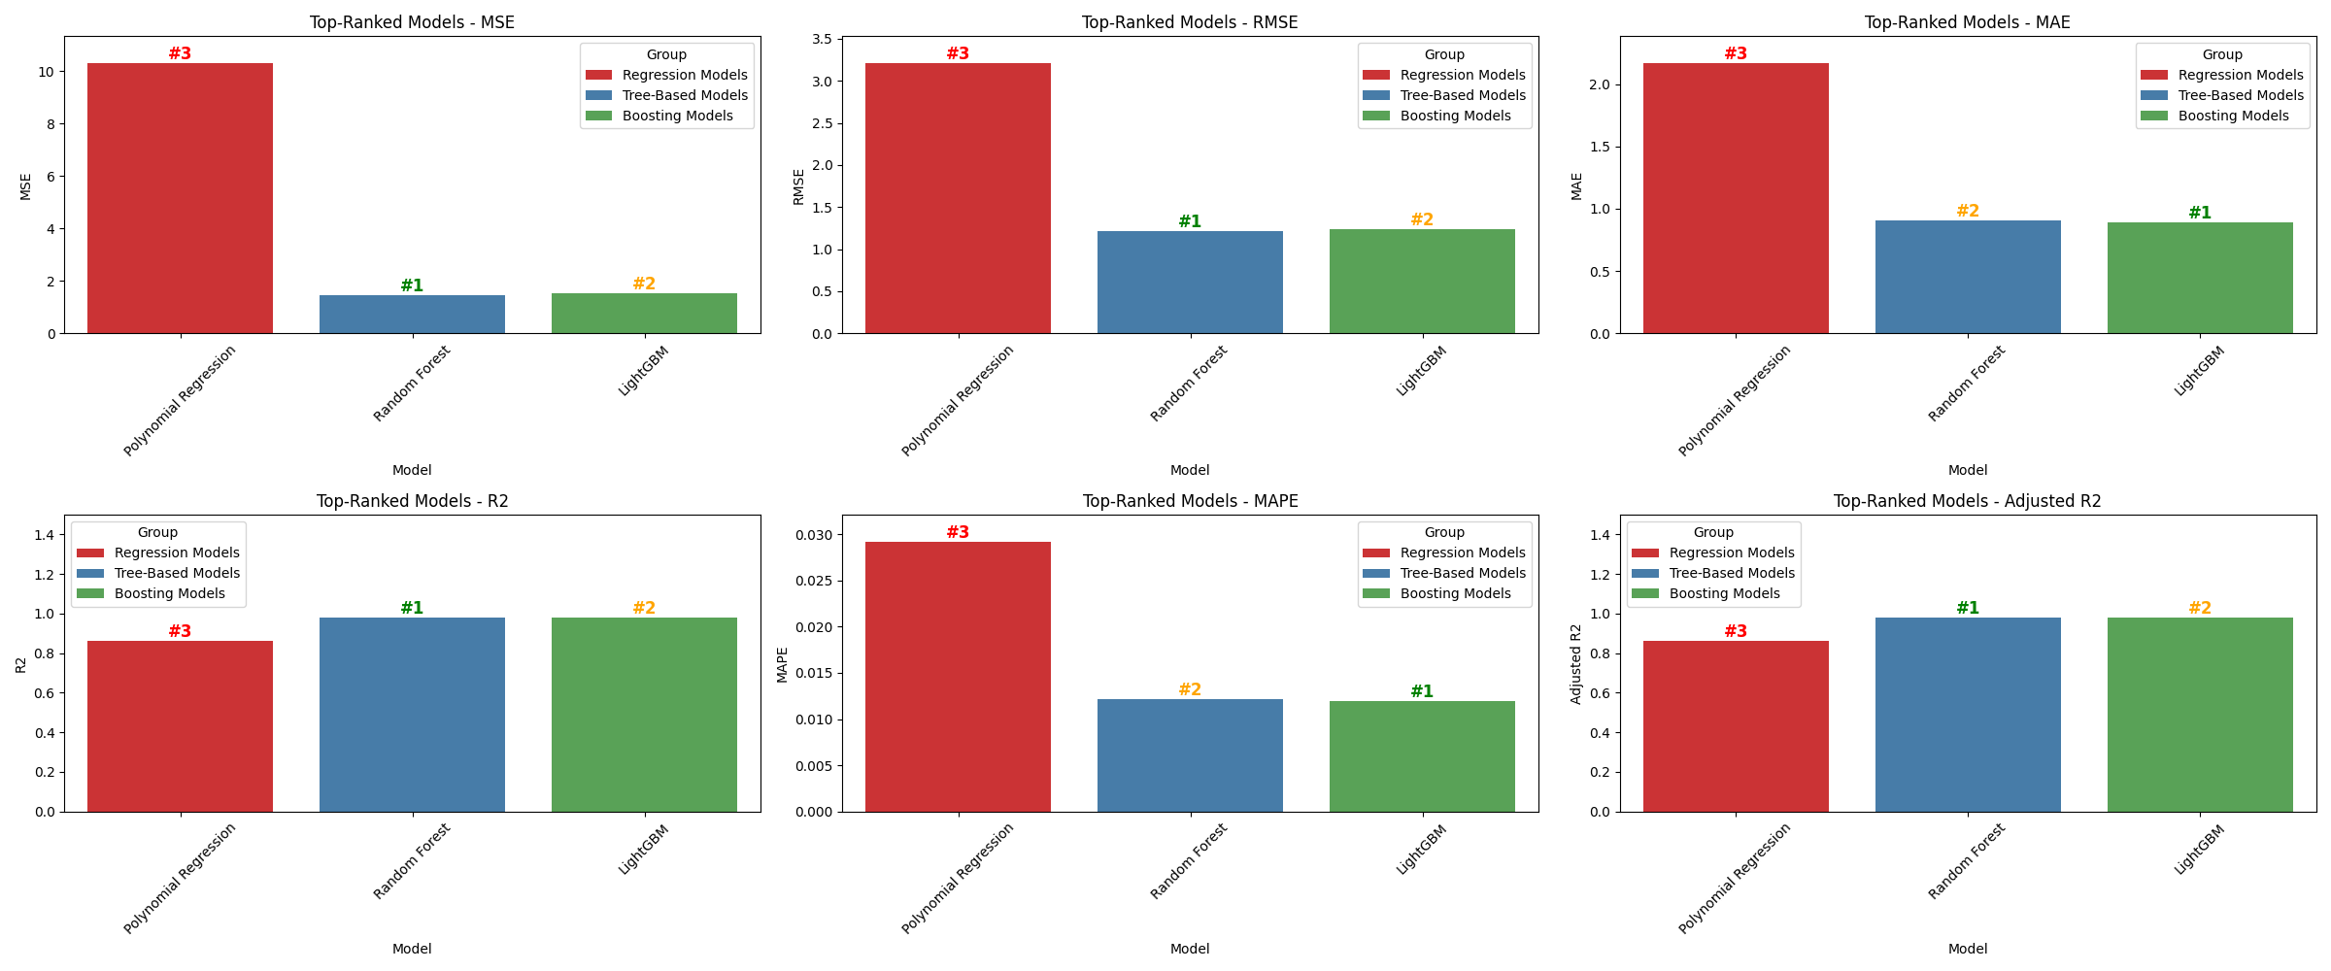
Consolidated model comparison

Slide 28
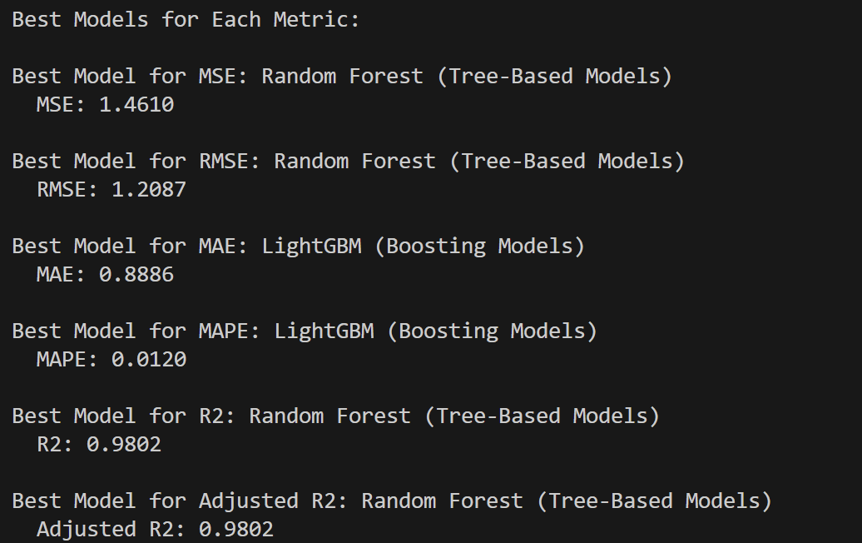
Consolidated model comparison

Slide 29
HGBRT
Grid Search :
Best Parameters: {'l2_regularization': 0.5, 'learning_rate': 0.05, 'max_depth': 20, 'max_iter': 200, 'max_leaf_nodes': 70, 'min_samples_leaf': 20}
Grid Search Metrics - MSE: 1.047353261840683 RMSE: 1.0234027857303707 R2: 0.985345137848044 Adjusted R2: 0.9853227503409374 MAPE: 0.010020441497539478
Random Search :
Best Parameters: {'min_samples_leaf': 20, 'max_leaf_nodes': 70, 'max_iter': 300, 'max_depth': None, 'learning_rate': 0.1, 'l2_regularization': 1}
Random Search Metrics - MSE: 1.051398552525148 RMSE: 1.0253772732634305 R2: 0.9852885350001747 Adjusted R2: 0.9852660610237007 MAPE: 0.010030918684147683
Bayesian Optimization :
Best Parameters: OrderedDict([('l2_regularization', 0.0), ('learning_rate', 0.07277113753137239), ('max_depth', 20), ('max_iter', 238), ('max_leaf_nodes', 70), ('min_samples_leaf', 20)])
Bayesian Optimization Metrics - MSE: 0.9869974645364588 RMSE: 0.9934774605075138 R2: 0.9861896531818773 Adjusted R2: 0.9861685557990204 MAPE: 0.009920163204059173

Slide 30
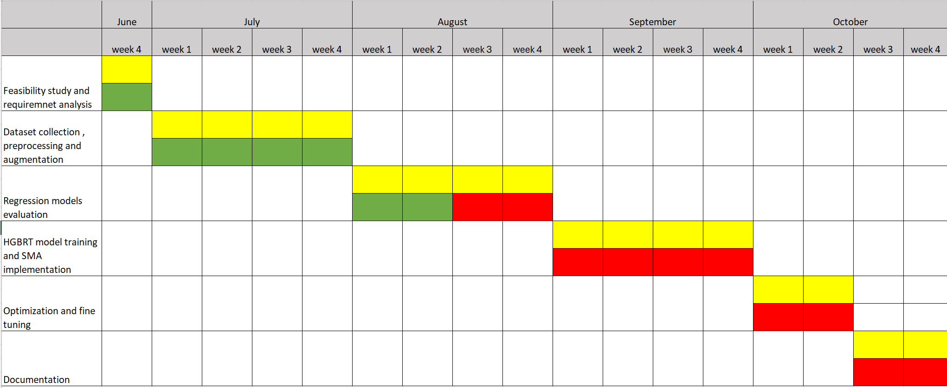
Timeline chart: -
Work done
Works Assigned
Works to be done

Slide 31
References: -
Gao Z. 5G Traffic Prediction Based on Deep Learning. Comput Intell Neurosci. 2022 Jun 24;2022:3174530. doi: 10.1155/2022/3174530. PMID: 35785055; PMCID: PMC9249458.
Zamzami, Ikhlas. (2022). Deep Learning Models Applied to Prediction of 5G Technology Adoption. Applied Sciences. 13. 119. 10.3390/app13010119.
L. Li and T. Ye, "Research on throughput prediction of 5G network based on LSTM," in Intelligent and Converged Networks, vol. 3, no. 2, pp. 217-227, June 2022, doi: 10.23919/ICN.2022.0006Qin, Z., Weng, J., Cui, Y., & Ren, K. Privacy-preserving image processing in the cloud. IEEE Cloud Computing (2018).
G. Nencioni, R. G. Garroppo and R. F. Olimid, "5G Multi-Access Edge Computing: A Survey on Security, Dependability, and Performance," in IEEE Access, vol. 11, pp. 63496-63533, 2023, doi: 10.1109/ACCESS.2023.3288334.
L. Zhang, W. Yang, B. Hao, Z. Yang and Q. Zhao, "Edge Computing Resource Allocation Method for Mining 5G Communication System," in IEEE Access, vol. 11, pp. 49730-49737, 2023, doi: 10.1109/ACCESS.2023.3244242.
Rekoputra, Nadhif Muhammad, Chia-Wei Tseng, Jui-Tang Wang, Shu-Hao Liang, Ray-Guang Cheng, Yueh-Feng Li, and Wen-Hao Yang. 2023. "Implementation and Evaluation of 5G MEC-Enabled Smart Factory" Electronics 12, no. 6: 1310

Slide 32
References: -
Xavier, Ruben, Rogério S. Silva, Maria Ribeiro, Waldir Moreira, Leandro Freitas, and Antonio Oliveira-Jr. 2024. "Integrating Multi-Access Edge Computing (MEC) into Open 5G Core" Telecom 5, no. 2: 433-450.
G. Chen, R. Huang, X. Tang and Q. Huang, "Research on the 5G MEC Co-construction and Sharing," 2024 4th International Conference on Neural Networks, Information and Communication Engineering (NNICE), Guangzhou, China, 2024, pp. 1187-1191, doi: 10.1109/NNICE61279.2024.10499087.

Slide 33
THANK YOU!

